Slide 1
SOCIAL MEDIA SENTIMENT AND BRAND REPUTATION MONITORING SYSTEM
Tools: Excel,Python,PostgreSQL,Power BI.
Dataset: social_media_data.
Prepared By: Shashank G,Adam Fayiz,Abdul Majid

Slide 2
PROJECT OBJECTIVE
To collect social media post related to a brand product.
To Analyse whether people use comments like
positive sentiment ,negative sentiment or
neutral sentiment.
To monitor the system so that it helps to understand business like customer satisfaction, product feedback, public opinion, brand reputation and trending topics.

Slide 3
To monitor brand reputation by comparing with other brands.
To identify the trending hashtag.
To compare performance across other platform.
To generate business insights.

Slide 4
PROJECT ARCHITECTURE
Excel
(Social media dataset)
Python
(cleaning, pandas, nltk.tokenize, matplotlib.pyplot, wordcloud)
PostgreSQL
(Database,queries)
Power BI
(Dashboard)

Slide 5
DATASET INFORMATION
ATTRIBUTE | DESCRIPTION
Total Records | 900
Platform | Twitter , Facebook , Instagram , Reddit
Brands | Apple , Google , Vivo , OPPO , Samsung
Sentiments | Positive , Negative , Neutral
Metrics | Likes , Share , Comments

Slide 6
WORKFLOW
Excel - used to create dataset , initial clean
and dataset.
Python - used for data cleaning and to do operation such as pandas , nltk.tokenize , matplotlib.pyplot , wordcloud.
PostgreSQL – used for data storage , queries processing and reporting.
Power BI – used for dashboard creation , KPI visualisation and analysis.

Slide 7
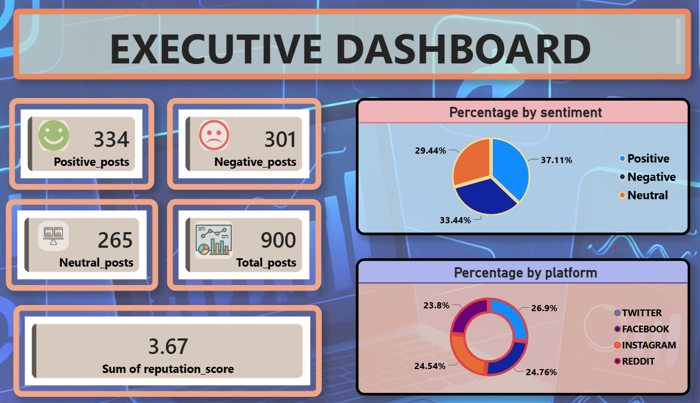
EXECUTIVE DASHBOARD
The Executive Dashboard provides a comprehensive overview of social media sentiment and brand performance across multiple platforms. It summarizes key metrics such as total posts, positive, negative, and neutral sentiments, along with the overall reputation score.visualizations highlight sentiment distribution and platform activity.
KPI CARDS - Positive post(shows the total number of positive sentiment post),Negative post(shows the total number of negative sentiment post),Neutral post(shows the total number of neutral sentiment post),Total post(shows the total number of negative sentiment post) &Reputation score(Measure overall brand reputation based on sentiment balance).
PIE CHART – Percentage by sentiment (shows the distribution of positive,negative & neutral sentiment.
DONUT CHART – percentage by platform (displays the distribution of posts across social media platforms)

Slide 8
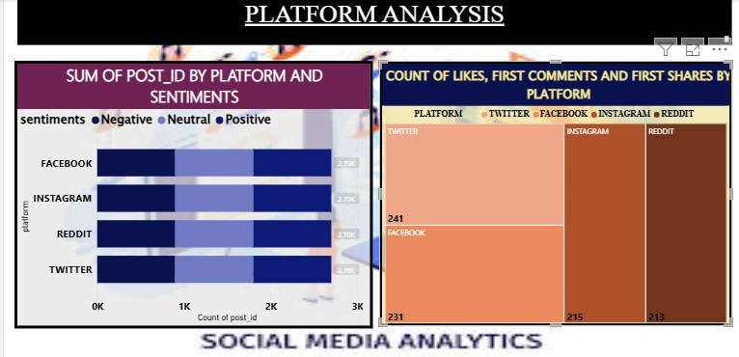
PLATFORM ANALYSIS DASHBOARD
The Platform Analysis Dashboard provides insights into social media performance across different platforms such as Twitter, Facebook, Instagram, and Reddit. It helps compare user engagement, content distribution, and sentiment trends to identify the most effective platform for audience interaction and brand communication.
Selecting a sentiment segment filters other visuals to show detailed platform-specific insights.
SENTIMENT DISTRIBUTION BY PLATFORM – Displays the proportion of Positive, Negative, and Neutral posts across each social media platform.
ENGAGEMENT COMPARISON BY PLATFORM – Compares likes, comments, and shares received on different platforms to measure audience engagement.
PLATFORM PERFORMANCE ANALYSIS – Identifies which platform generates the highest user interaction and content reach.
SOCIAL MEDIA INSIGHTS – Helps understand audience behavior, platform effectiveness, and opportunities to improve social media strategy.

Slide 9
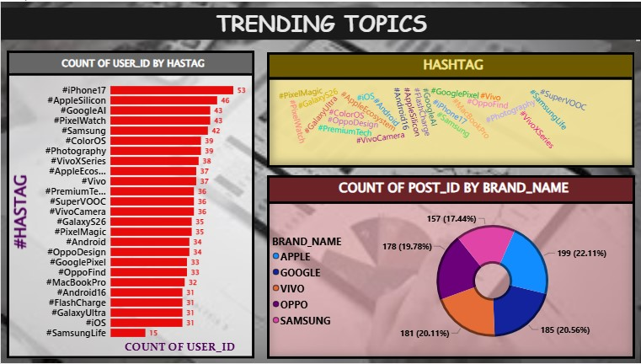
TRENDING TOPICS DASHBOARD
The Trending Topics Dashboard provides insights into the most discussed hashtags, keywords, and brands across social media platforms. It helps identify emerging trends, popular conversations, and brand visibility by analyzing user-generated content and engagement patterns. It helps identify what users are discussing most frequently and which brands receive the highest attention.
TOP TRENDING HASHTAGS – Displays the most frequently used hashtags based on user activity and post volume.
HASHTAG WORD CLOUD – Visualizes popular hashtags, making it easy to identify trending discussions and topics.
BRAND MENTION ANALYSIS – Compares the number of posts associated with different brands to measure online visibility and audience interest.
TREND INSIGHTS – Helps track emerging topics, consumer interests, and market trends across social media platforms.

